Slide 1

Federal Trade Commission
Consumer Protection in the Auto Industry
.
Cindy Liebes
Regional Director
Federal Trade Commission
Southeast Regional Office
The views expressed in this presentation are my own, and do not necessarily reflect the views of the Commission or any individual Commissioner

Slide 2

WARNING TO AUTO DEALERS WHO ADVERTISE DECEPTIVELY:
THE FEDERAL TRADE COMMISSION IS CLOSER THAN YOU THINK

Slide 3
FTC’s Auto Mission
Auto transactions are increasingly important to the FTC’s consumer protection mission
  Autos are often the second biggest financial transaction for many consumers
  Dodd-Frank Wall Street Reform and Consumer Protection Act made the FTC the primary federal enforcement agency for many auto dealers
Notes:
Under the Dodd-Frank Act, the FTC has:
Exclusive jurisdiction over many dealers – complex but generally looks at sales or leases and servicing, and dealers that routinely assign financing to unaffiliated third parties, typically franchise dealers
Concurrent jurisdiction with CFPB over non-bank lenders and buy here, pay here dealers
Primary enforcement agency for many auto dealers
APA rulemaking authority in auto finance area

Slide 4

FTC’s Law Enforcement Tools
Recent deceptive advertising enforcement actions brought under several statutes and rules:
  FTC Act
    Prohibits unfair and deceptive trade practices
    Flexible law that can be applied to many different situations, entities and technologies
  Truth in Lending Act (TILA) and its implementing Regulation Z
  Consumer Leasing Act (CLA) and its implementing Regulation M

Slide 5

FTCBASICS
The FTC looks at ads from the perspective of a reasonable consumers.
Ads may be literally truthful – and still deceptive.
For a disclosure to be effective, it must be “clear and conspicuous.”
Fine print won’t fix deception.
Any media – Any place

Slide 6
Disclosures
Cannot Cure a False Claim
Good Design: Greater Effectiveness
  Size matters
  Placement matters
  Color counts
  Use of graphics can help
Notes:
If qualifying information is necessary to prevent an ad from being misleading, advertisers must present the information clearly and conspicuously.
Remember, however, that a disclosure cannot cure a false claim. It can only qualify or limit the claim.
In evaluating effectiveness of disclosures, the FTC considers factors like:
• Prominence: whether the qualifying information is prominent enough for consumers to notice and read (or hear).
Caution: mouse print; rapid fire delivery
• Presentation: whether the qualifying information is presented in easy- to-understand language that does not contradict other things said in the ad and is presented at a time when consumers’ attention is not distracted elsewhere
Caution: Jargon or technical terms; buried in fine print; multiple asterisks; grey print; loud music )
• Placement: whether the qualifying information is located in a place and conveyed in a format that consumers will read (or hear)
Caution: turned sideways on the ad
• Proximity: whether the qualifying information is located in close proximity to the claim being qualified.
Caution: back of direct mail; multiple clicks away

Slide 7
RECENT LAW ENFORCEMENT

Slide 8
FTC Enforcement Efforts
2012: Deceptive “pay-off your trade”
(negative equity)
2013: Deceptive price, discount & rebate
2014: Deceptive price, leasing & finance (Operation Steer Clear)
2015: Deceptive price, leasing & finance cases; deceptive add-on cases; & deceptive auto loan modification (Operation Ruse Control)

Slide 9
FTCALLEGATIONS
Deceptive “$0 down” claims
Deceptive teaser lease rates
Undisclosed balloon payments
Eye-catching rates or deals with important terms or conditions disclosed in small print – or not at all
Deceptive offers involving negative equity
Misleading prize promotions
CLA or TILA triggering terms used without required disclosures
Other deceptive or unfair practices

Slide 10

Operation Ruse Control
  Nationwide and cross-border crackdown on deception and fraud in the auto marketplace.
    Thirty-two state, federal, and Canadian agencies took part in the sweep, bringing a total of 252 law enforcement actions.
    The actions involved a range of charges, including deceptive advertising, criminal automotive loan application fraud, odometer fraud, and deceptive marketing of car title loans.
  FTC Law Enforcement Actions, including:
    Deceptive add-ons
    Deceptive & misleading advertising
    Deceptive auto loan modification scheme
    Deceptive auto servicing & collection
    Auto Warranty issues
Notes:
Two of the FTC actions involve add-ons – extra products or services tacked on to the sale, lease, or financing of a car. Typical add-ons include extended warranties, guaranteed automobile protection (GAP) insurance, credit life insurance, undercoating, and the like. According to the FTC, California-based National Payment Network deceptively claimed in online ads and through a network of authorized dealers that car buyers who bought its biweekly payment program would save money. What consumers weren’t told was that the cost of the add-on often outstripped any savings. The FTC says that was a material fact that should have been disclosed upfront. In a related action, the FTC sued New Jersey dealerships Matt Blatt Inc. and Glassboro Imports LLC for pitching NPN’s deceptive add-ons and pocketing hefty commissions. To settle the case, NPN will provide consumers with $2.475 million in refunds and fee waivers. The dealerships will turn over an additional $184,000.
Three of the Operation Ruse Control cases challenge allegedly deceptive advertising by auto dealers. Some crossed the line by using headlines to tout bargain prices while failing to disclose – or failing to adequately disclose – the true cost of the deal. For example, ads for Cory Fairbanks Mazda of Longwood, Florida, pitched “used cars as low as $99.” But according to the FTC, $99 was just the minimum bid for cars offered at a liquidation sale and that didn’t include substantial mandatory fees. In a similar vein, the FTC says the dealership’s ads included photos of loaded cars without clearly explaining that some pictured features – like spoilers and sunroofs – weren’t included in the price.
One case against Florida-based Regency Financial Services and CEO Ivan Levy. According to the FTC, the company charged financially-strapped consumers upfront fees to negotiate changes to their car notes, but often didn’t provide anything in return.

Slide 11
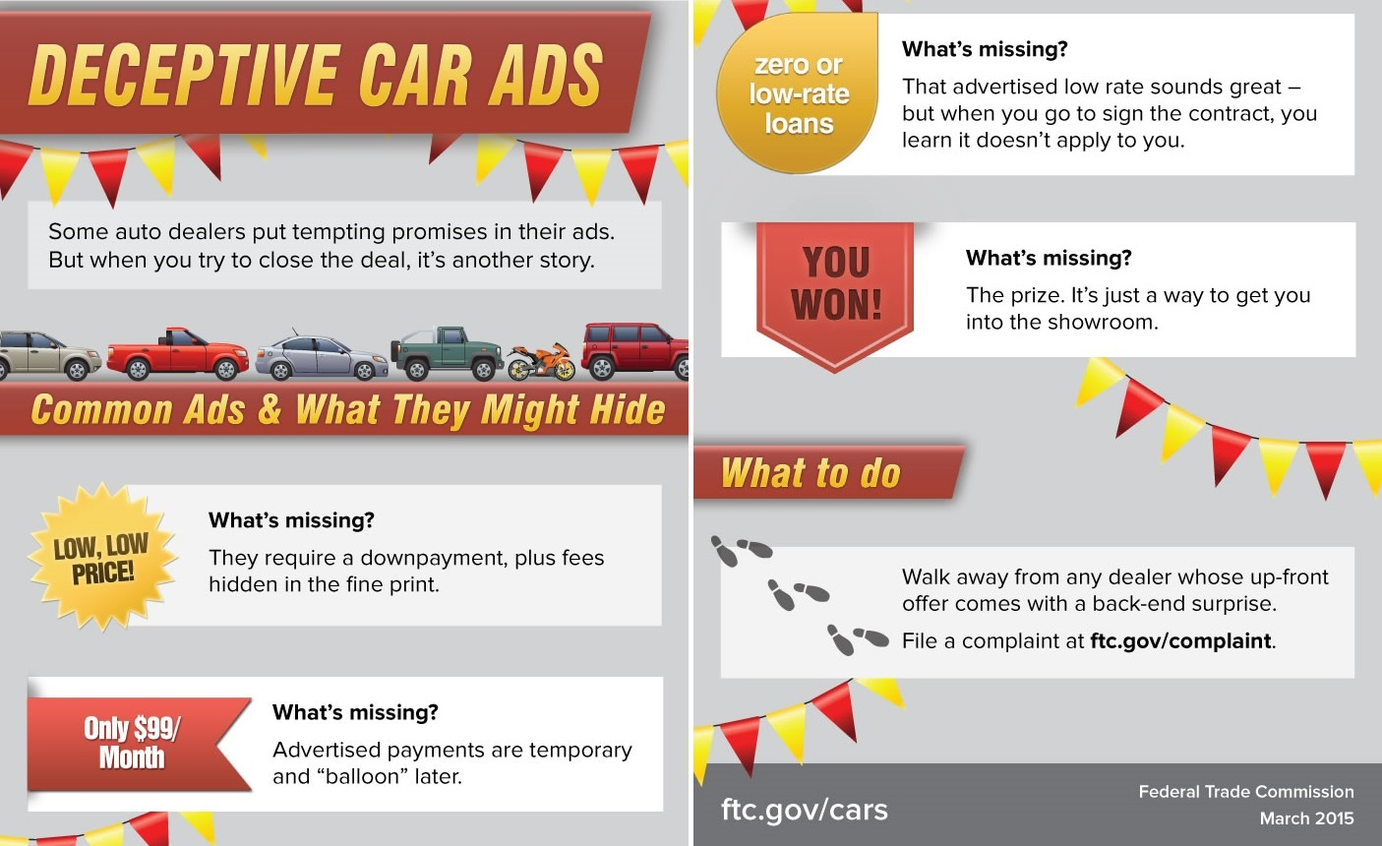

Slide 12
NAMVBC Partnerships
Our NAMVBC partners from CA, LA, OK, TX, VA, British Columbia and Ontario, Canada contributed over 100 actions to Operation Ruse Control!

Slide 13

Deceptive “Pay Off Your Trade” Claim
We will pay off your trade NO MATTER how much you owe!
Notes:
Part of a group pf four Administrative Complaints Filed Against Dealerships (2012)
Alleged FTC Act violations (deception):
“We’ll pay off your trade, no matter what you owe”
Implied consumer would have no further obligation on prior loan
In fact, dealer rolled negative equity into new loan (or in one case made consumer pay out of pocket). Thus the promised savings were illusory. The consumers, rather than the auto dealers, end up paying off the vehicles' negative equity.

Slide 14

Deceptive “Max Your Tax” Claim
Notes:
Trophy Nissan case: Alleged violations of Section 5 of the FTC Act, the Consumer Leading Act, and the Truth in Lending Act for advertising that the dealership would accept any trade-ins, even those with negative equity. In reality, the consumers' auto loans and leases include the negative equity.
Alleged FTC Act violations (deception):
“Trophy Nissan will match your tax refund so you can use it for a down payment”
In fact, the company would match the tax refund only up to $1,000
This was disclosed in a small print disclosure at the bottom of the ad, which the Commission alleged wasn’t adequate – i.e., it wasn’t sufficiently prominent that consumers would see it.

Slide 15

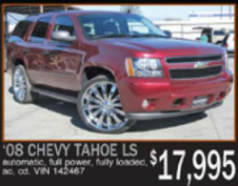
Deception Low Purchase Price Claims
Notes:
Casino Auto Sales – announced in 2014 as part of Operation Steer Clear
Advertised cars with low purchase prices
For example, it advertised a 2008 Chevy Tahoe LS for $17,995.
In fact, as seen in the fine print, the dealer required consumers to pay and additional $5,000 to purchase the advertised vehicle. So, the purchase price wasn’t really $17,995.

Slide 16
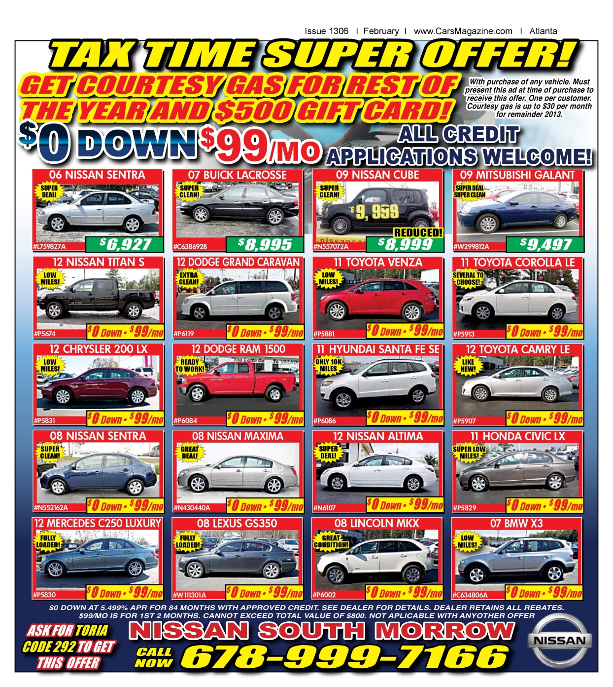
Low Monthly Payment Claims
Notes:
Nissan South Atlanta –Georgia
Case announced as part of Operation Steer Clear in 2014.
Prominently advertised “0 Down $99/mo”
Unfortunately, under this deal, consumers paid $99 each month for the first two months only, and they would owe different monthly amounts for the remaining 82 months.
This advertisement also triggered TILA because it contained the triggering claim – the monthly payment.
The Commission alleged that the company failed to disclose or disclose adequately the required information under TILA:
a. The amount or percentage of the down payment.
b. The terms of repayment, including any balloon payment.
c. The “annual percentage rate,” using that term, and, if the rate may be increased after consummation, that fact.
That information was contained at the bottom of the ad in small text.

Slide 17

Failure to Disclose Restrictions & Qualifications
Notes:
In the ad, the dealer offered closed-end credit for a 72-month term, however, the dealer did not include required information triggered by the advertisement, such as the down payment amount, the monthly payment amount, and the annual percentage rate.
The dealer’s advertisements typically included disclaimers that appeared in fine print and muted colors that were difficult to read. The disclaimers routinely stated, in part, that the advertised prices and financing deals included all factory rebates.
In fact, often, the advertised discount and price were not generally available to consumers and were subject to various qualifications or restrictions. Such qualifications or restrictions included, for example, being a recent college graduate.

Slide 18
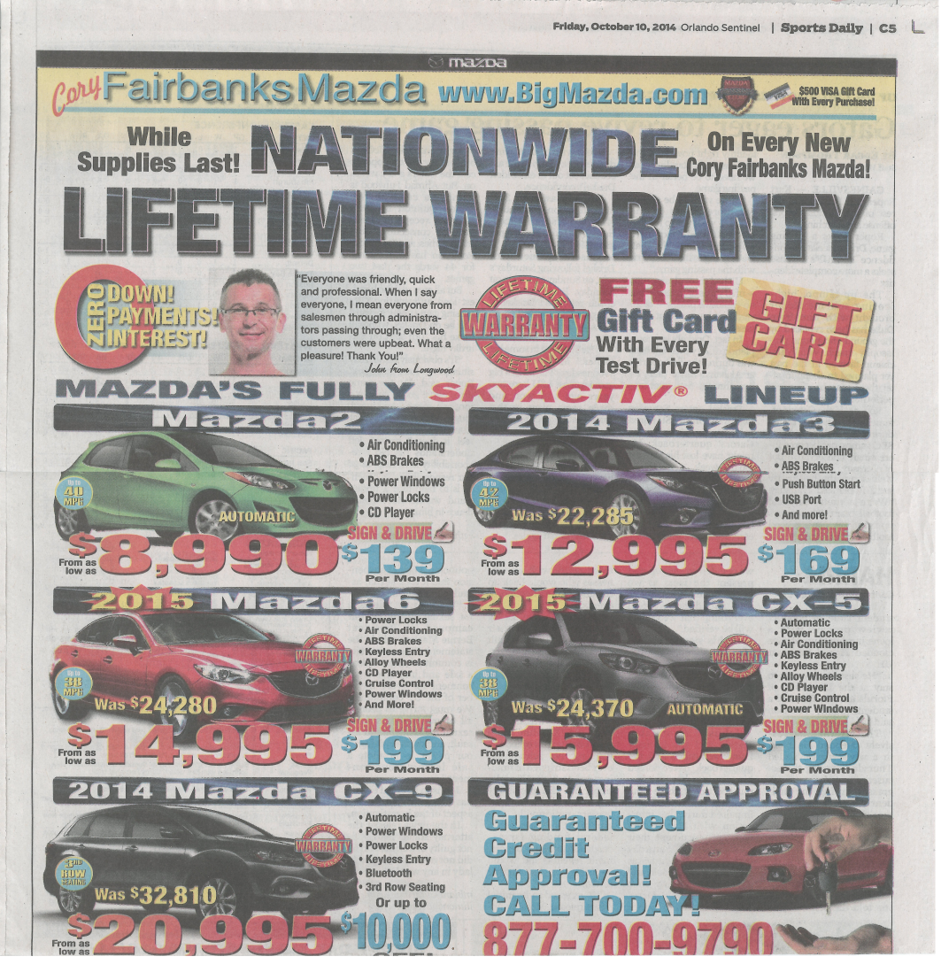

Notes:
Corey Fairbanks Mazda,
According to the FTC’s complaint, the respondent has misrepresented: (1) Vehicle purchase prices; (2) that advertised prices, discounts, rebates, bonuses, and incentives are available to all consumers; (3) the prices for added features such as spoilers and sunroofs; (4) that vehicles are available for sale or lease for zero down, zero payments, or zero interest; (5) that vehicles are available for $99; and (6) that consumers can pay $0 at the inception of a lease to lease the advertised vehicle for the advertised monthly payment amount. The complaint alleges therefore that the representations are false and misleading in violation of Section 5 of the FTC Act. In addition, the complaint alleges the respondent violated the Consumer Leasing Act (‘‘CLA’’) and Regulation M for failing to disclose or to disclose clearly and conspicuously certain costs and terms when advertising vehicles for lease.
The dealership is prohibited from misrepresenting the cost of purchasing, financing, or leasing a vehicle, and from advertising a price or discount for a vehicle unless the price or discount is available to all consumers. The order also prohibits the dealership from failing to clearly and conspicuously disclose required leasing information and complying with the Consumer Leasing Act and Regulation M.

Slide 19
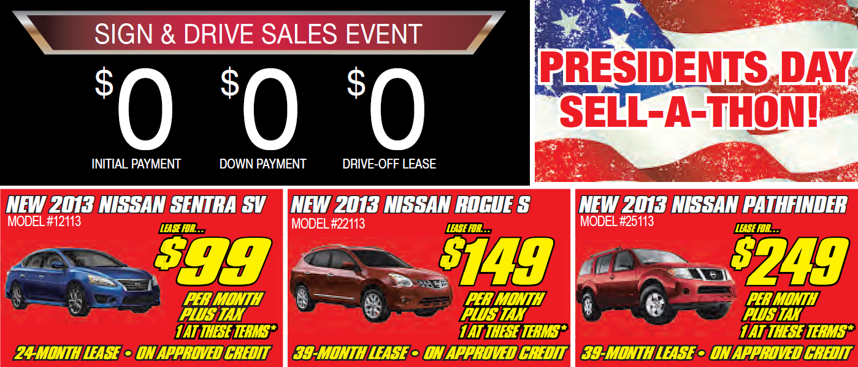
Deceptive “$0 Down” Lease Claims
Notes:
Ads for Ross Nissan of El Monte focused on nothing, too – as in “$0 INITIAL PAYMENT, $0 DOWN PAYMENT, $0 DRIVE-OFF LEASE.” The California company made the same claims in Spanish language ads. Other ads promised “$0 down*, 0% APR financing*, 0 payments*, and 0 problems.” Well, the FTC had a problem with – among other things – the deceptive use of “zero.” The dealership’s “$0 at lease inception” deal wasn’t applicable if consumers wanted the cars in the ads for the advertised monthly payment. What about “$0 down payment?” The FTC says people, in fact, had to pay a down payment to finance the vehicles for the monthly payment featured in the ads. And “0% APR?” The annual percentage rate for financing those cars for the advertised payment was way more than 0%. (The complaint against Cory Fairbanks Mazda made similar allegations about deceptive “zero” claims.)
Ad Prominently features $0 down claims
Below the $0 down statement, the ad features numerous vehicles. For example, it offers a 2013 Nissan Sentra SV for $99 per month plus tax for a 24-month lease.
While other vehicles on this ad were listed for sale, these three were the only ones offered for lease.
To obtain the 2013 Nissan Sentra for $99 per month as part of a 24 month lease, the consumer would have to pay $4100 a signed plus registration and taxes. Thus, the amount the consumer had to pay to “drive off” was substantiatlly more than $9 down.
In addition to alleging that the claim was false. The Commission also alleged that this ad violated the Consumer Leasing Act and Regulation M.
_____________
The message for dealers: Don’t lure customers in with misleading “zero” promises.

Slide 20
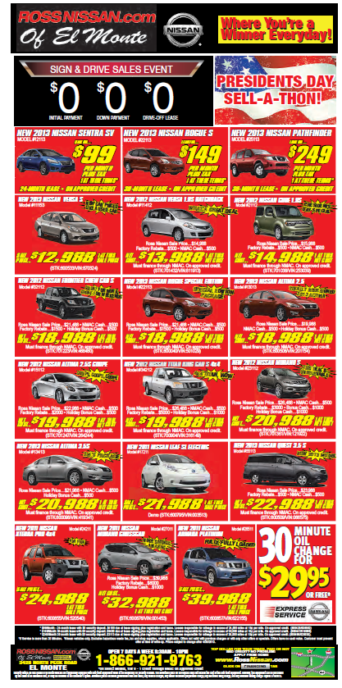
$99/Month – 24 month lease with $0 security deposit. $4100 due at lease signing plus registration and taxes. Lessee responsible for mileage in excess of 24,000 miles at 15¢ per mile. On approved credit.
Notes:
Again, the dealership (Ross Nissan El Monte) tried to disclaim the $0 down claim and to comply with the CLA by use of a minuscule disclosure at the bottom of the ad.
The Commission alleged that this disclosure wasn’t clear and conspicuous. Therefore, it is treated as if the statement doesn’t appear there at all.

Slide 21

Deceptive Sweepstakes Claims

Slide 22
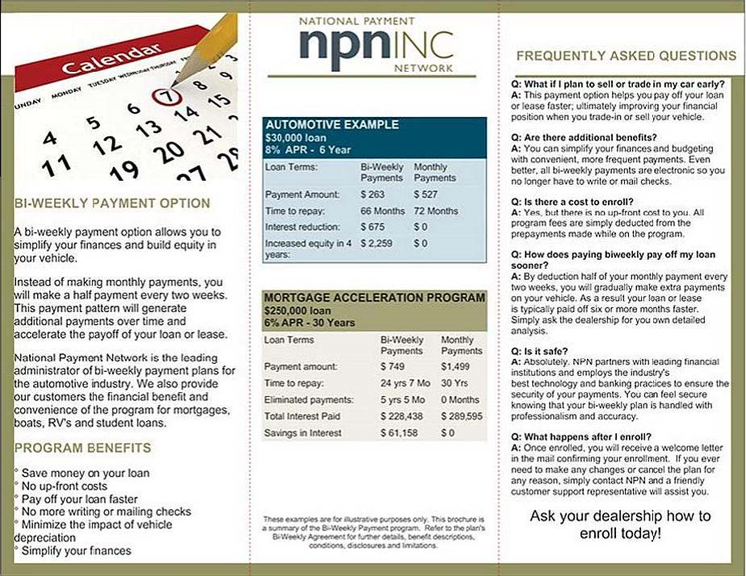
Deceptive Add-on Finance Plan
Notes:
National Payment Network, Inc. (NPN): The FTC charged that NPN, headquartered in San Mateo, Calif., allegedly violated the FTC Act by deceptively pitching consumers an auto payment program – both online and through a network of authorized auto dealers -- that it claimed would save consumers money. NPN failed to disclose that the significant fees it charged for the service often cancelled out any actual savings. The fees to enroll in NPN’s program averaged $775 on a standard five-year auto loan.
Matt Blatt Inc. and Glassboro Imports, LLC (Matt Blatt dealerships): In a related case, the FTC alleged that Matt Blatt dealerships, with multiple locations in New Jersey, violated the FTC Act by failing to disclose or adequately disclose the fees associated with NPN’s add-on service and that many consumers would not save money overall due to the program’s significant fees. Matt Blatt dealerships received a commission for each of the more than 1,000 consumers they enrolled.
NPN and Matt Blatt dealerships have agreed to settle the FTC charges, and under proposed consent orders are prohibited from misrepresenting that a payment program will save consumers money, unless the amount of savings is greater than the total amount of fees and costs charged in connection with the program. They also are prohibited from misrepresenting that the payment programs or their associated fees will improve, repair or otherwise affect a consumer’s credit record.
NPN will refund more than $1.5 million to consumers, and waive another $949,000 in fees to current customers during the fee waiver period. Matt Blatt dealerships also will pay $184,000 to the FTC as part of the settlement.

Slide 23
Typical Order Provisions in Administrative Cases
Dealers barred from misrepresenting the cost of purchasing or leasing a vehicle
If dealers misrepresented financing or leasing terms, they were barred from misrepresenting such terms
If violated TILA or CLA, they were barred from violating the applicable law
All dealers also required to:
  Maintain and produce records upon request (5 years)
  Initial compliance report and follow-up reports upon request
  Notify FTC about changes in business
Order effective for 20 years

Slide 24

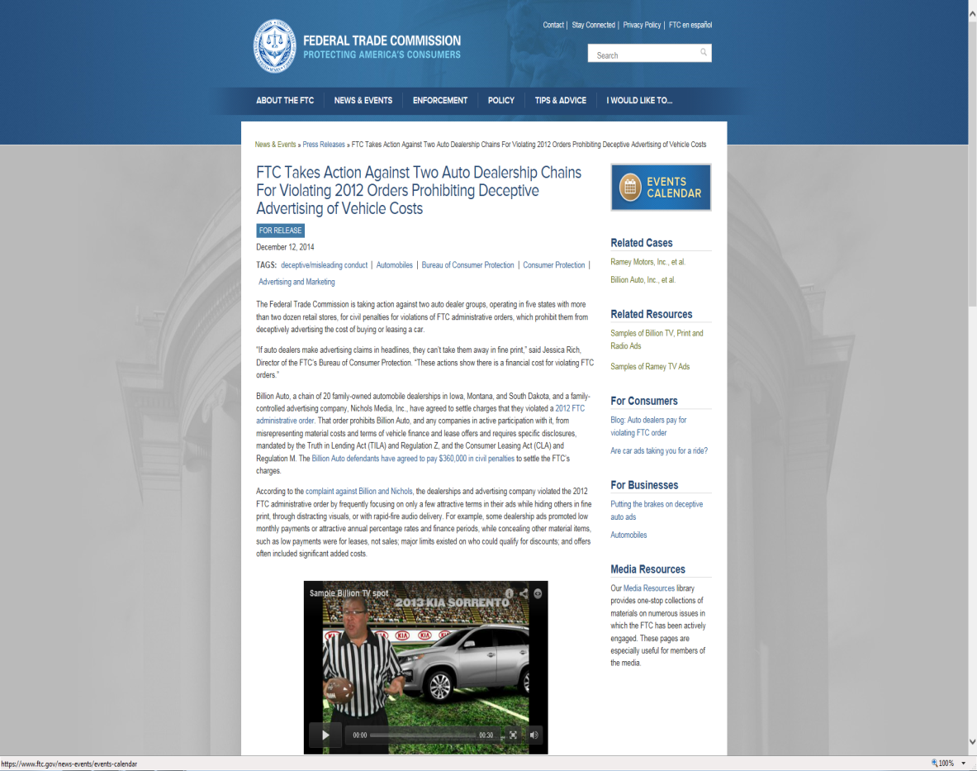
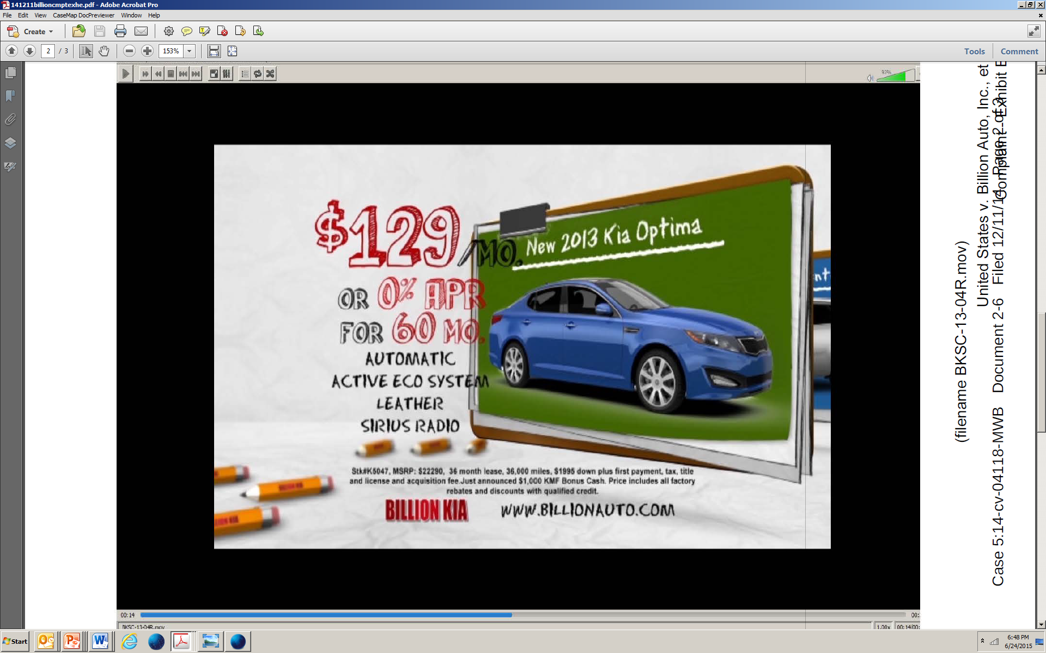
Civil Penalties for Order Violations
Billion Auto – settled for $360,000
Ramey Motors – complaint for civil penalties pending
Notes:
Violations of FTC administrative orders issued in prior negative equity cases. In previous ads the companies advertised: We’ll pay off your trade, no matter what you owe.” Rolled the amount of negative equity into the finance package of the new car.” Although the companies halted the negative equity claims, they misrepresented other lease and credit terms in alleged violation of the orders.
Billion Auto, a chain of 20 family-owned automobile dealerships in Iowa, Montana, and South Dakota, and a family-controlled advertising company, Nichols Media, Inc., have agreed to settle charges that they violated a 2012 FTC administrative order. That order prohibits Billion Auto, and any companies in active participation with it, from misrepresenting material costs and terms of vehicle finance and lease offers and requires specific disclosures, mandated by the Truth in Lending Act (TILA) and Regulation Z, and the Consumer Leasing Act (CLA) and Regulation M. The Billion Auto defendants have agreed to pay $360,000 in civil penalties to settle the FTC’s charges.
According to the complaint against Billion and Nichols, the dealerships and advertising company violated the 2012 FTC administrative order by frequently focusing on only a few attractive terms in their ads while hiding others in fine print, through distracting visuals, or with rapid-fire audio delivery. For example, some dealership ads promoted low monthly payments or attractive annual percentage rates and finance periods, while concealing other material items, such as low payments were for leases, not sales; major limits existed on who could qualify for discounts; and offers often included significant added costs.
In a separate action seeking civil penalties, the FTC has charged Ramey Motors, Inc., and three affiliated dealerships, in several locations in Virginia and West Virginia, with violating a similar 2012 FTC administrative order. Among other things, Ramey Motors’ ads allegedly misrepresented the costs of financing or leasing a vehicle by concealing important terms of the offer, such as a requirement to make a substantial down payment. The complaint also charges Ramey Motors with failing to make credit disclosures clearly and conspicuously, as required by the TILA. The FTC also alleges that the auto dealer group failed to retain and produce appropriate records to the Commission to substantiate its offers. Ramey Motors and its affiliates are subject to $16,000 in civil penalties for each alleged violation of the FTC administrative order.

Slide 25

Deceptive Auto Loan Modification
Notes:
Stipulated order entered 7/30/15, includes a ban on telemarketing and a ban on debt relief services, as well as comprehensive injunctive prohibitions and a $330,000 judgment. This defendant is also facing criminal charges in Palm Beach County Florida relating to his deceptive auto modification scheme.

Slide 26
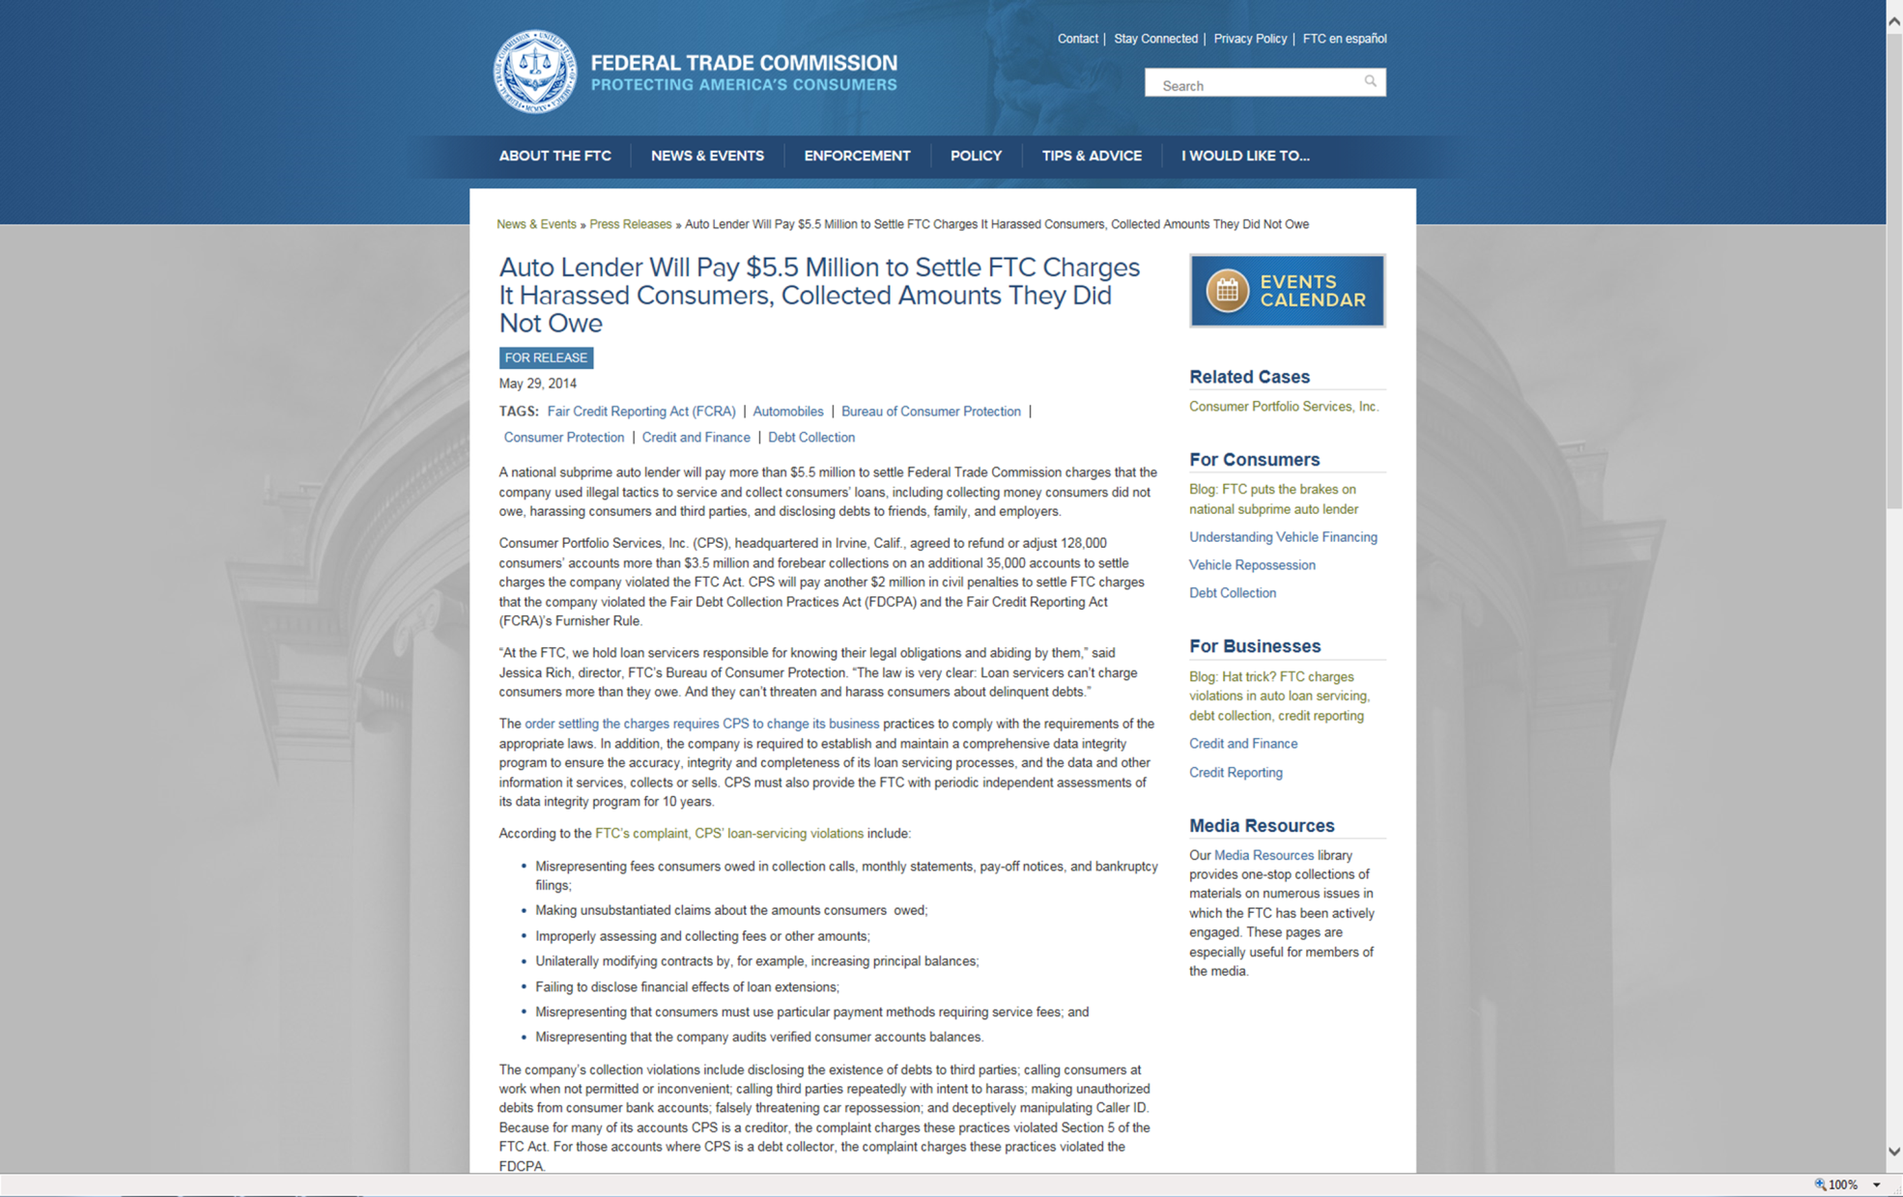
Other Auto Issues- Subprime auto financing

Slide 27
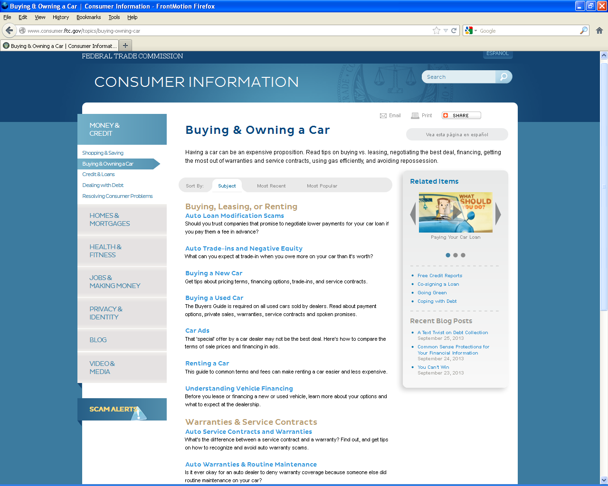
Consumer Educational Materials
“Money & Credit” → “Buying & Owning a Car”

Slide 28
COMPLIANCE RESOURCES FOR AUTO DEALERS & FINANCE PROFESSIONALS

Slide 29
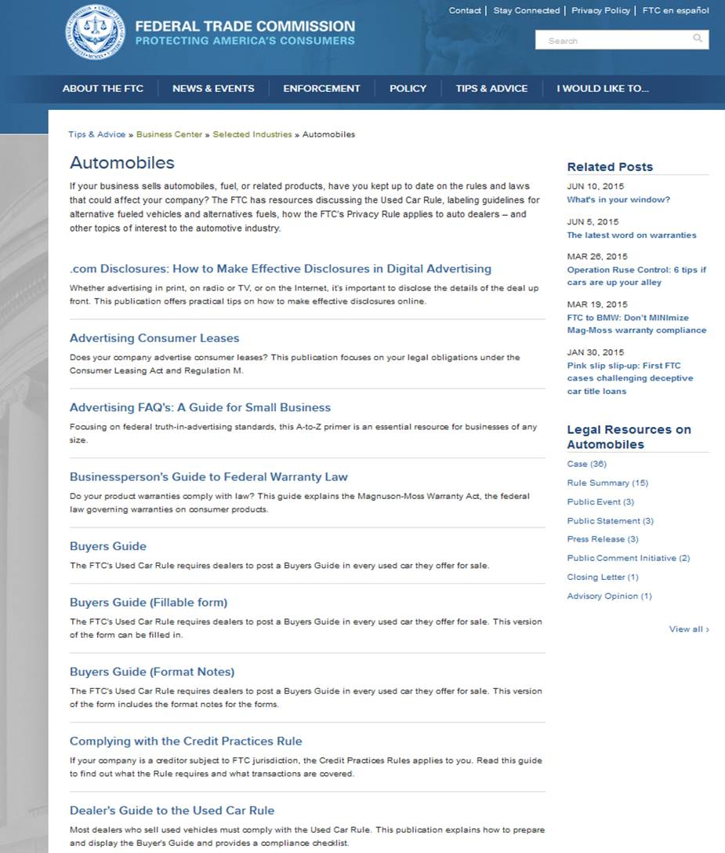
business
.ftc
.gov
Relevant Business Blog posts
Plain-language compliance
guides
Legal resources, including cases

Slide 30
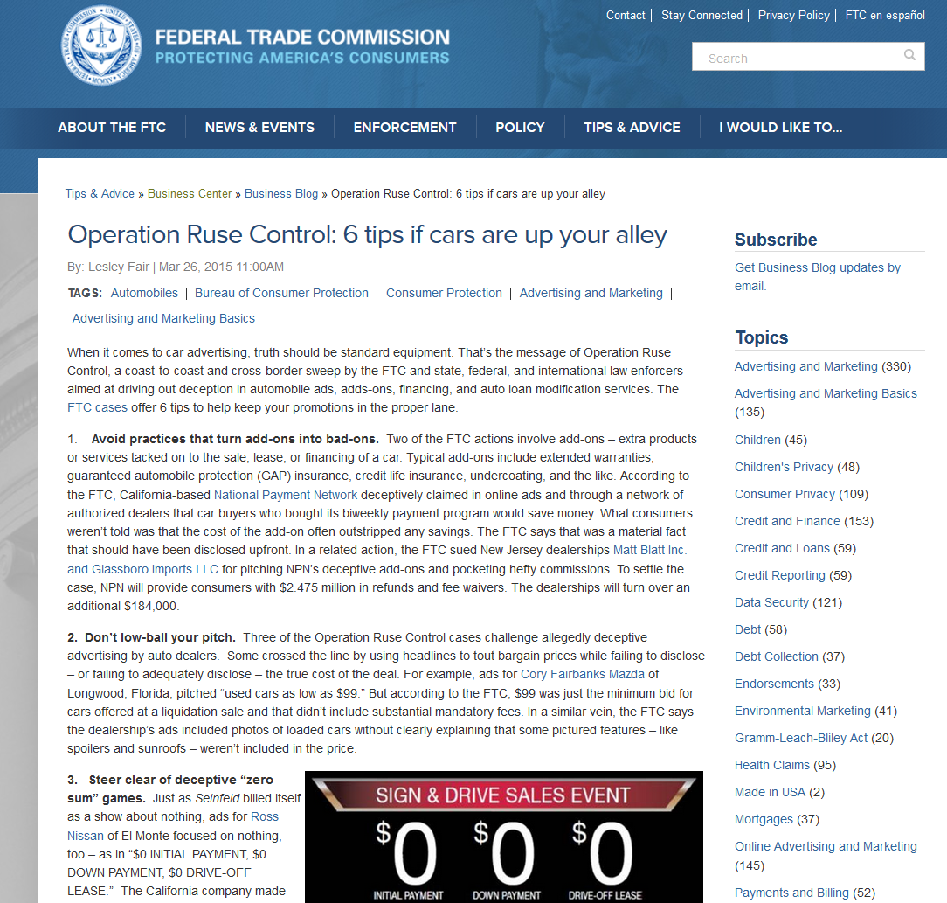
Business
Blog

Slide 31
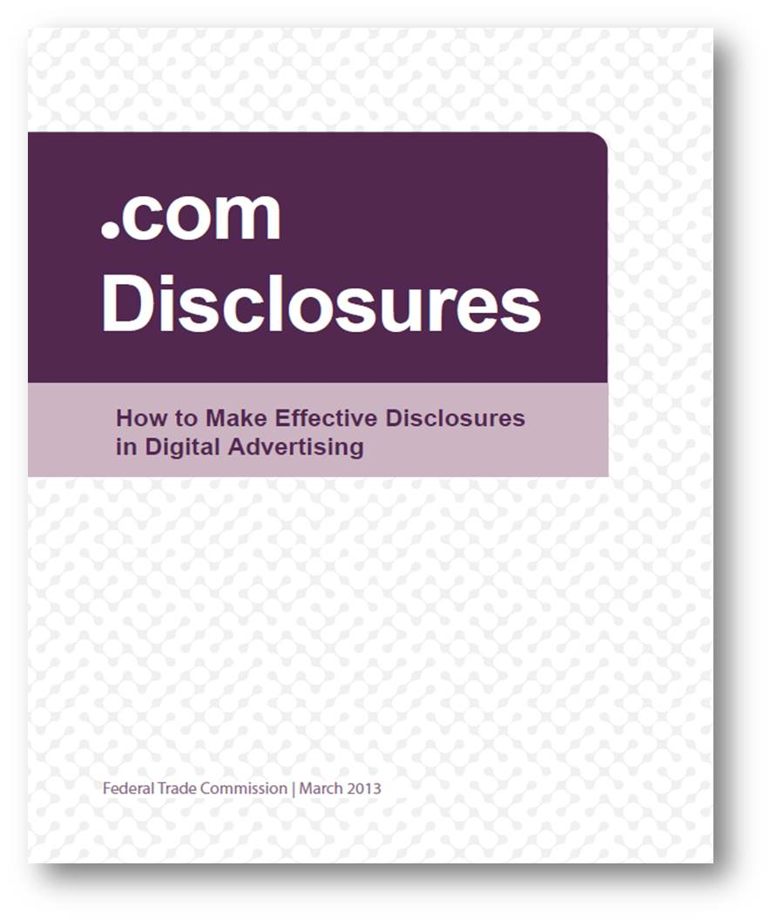

Slide 32
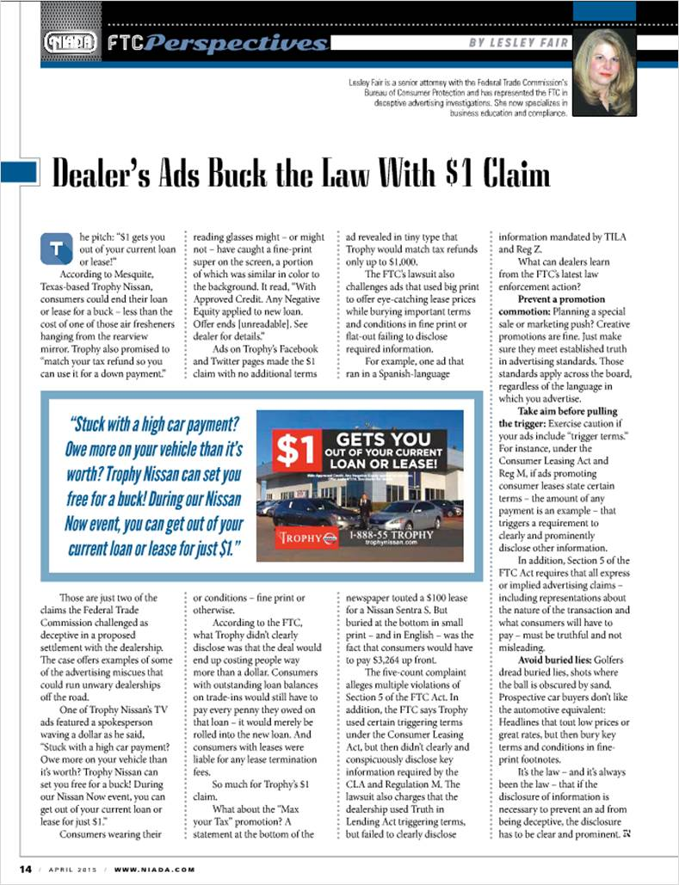
FTC COLUMN IN NIADA MAGAZINE

Slide 33
Educational Materials
  Additional FTC Resources:
    Order free materials from bulkorder.ftc.gov
    Visit ftc.gov/subscribe to sign up for Consumer and Business Blog updates.
    Visit consumer.ftc.gov and business.ftc.gov and bookmark auto resource pages Link, post, tweet, blog, adapt.
    All FTC materials are in the public domain.

Slide 34

Cindy A. Liebes
FEDERAL TRADE COMMISSION
SOUTHEAST REGIONAL OFFICE
225 PEACHTREE STREET
SUITE 1500
ATLANTA, GA 30303
Phone: 404-656-1359
email: cliebes@ftc.gov

